Slide 1


Bayesian Calibration with Transitional MCMC
Ander Gray, Adolphus Lye, Dominic Calleja, Edoardo Patelli
Ander.Gray@Liverpool.ac.uk

Slide 2
Who am I?
Msci Physics: Queens University Belfast (2013-2017)
Phd UQ: Uni of Liverpool/ CCFE (2017 – present)
(Working) Thesis: “Uncertainty Quantification in Fusion Neutronics with Imprecise Probabilities”
Mainly interested in:
    Uncertainty Propagation
    Probabilistic Arithmetic
    Dependencies
    Nuclear Data
    Neutron transport MC
    Calibration and V&V
Contact: Ander.Gray@Liverpool.ac.uk
Projects: https://github.com/AnderGray

Slide 3
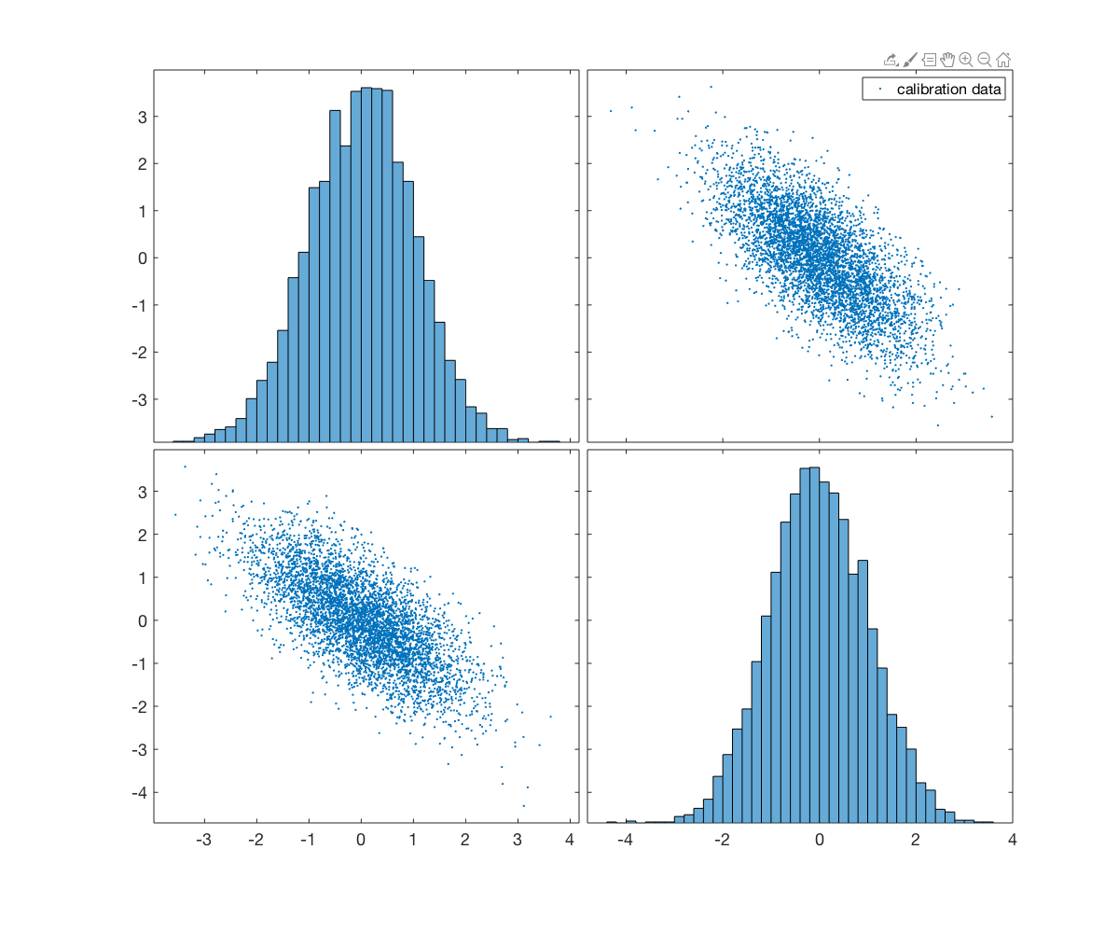
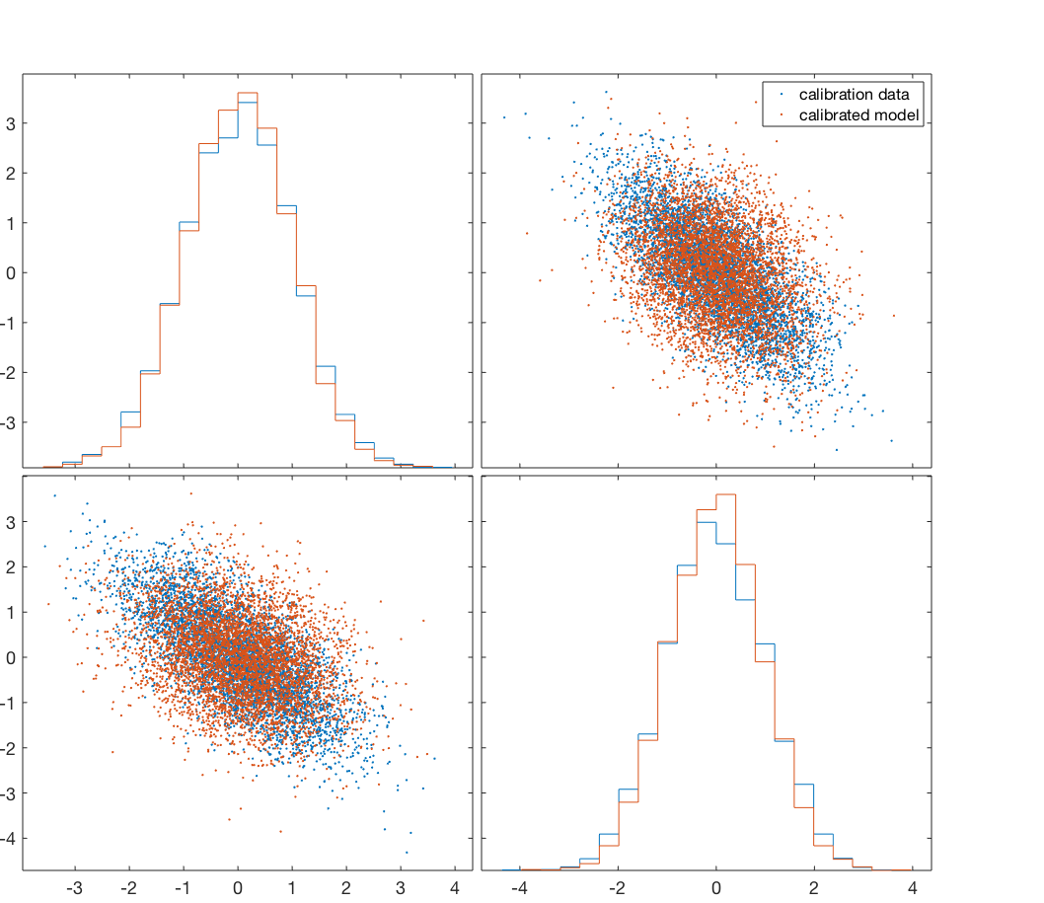
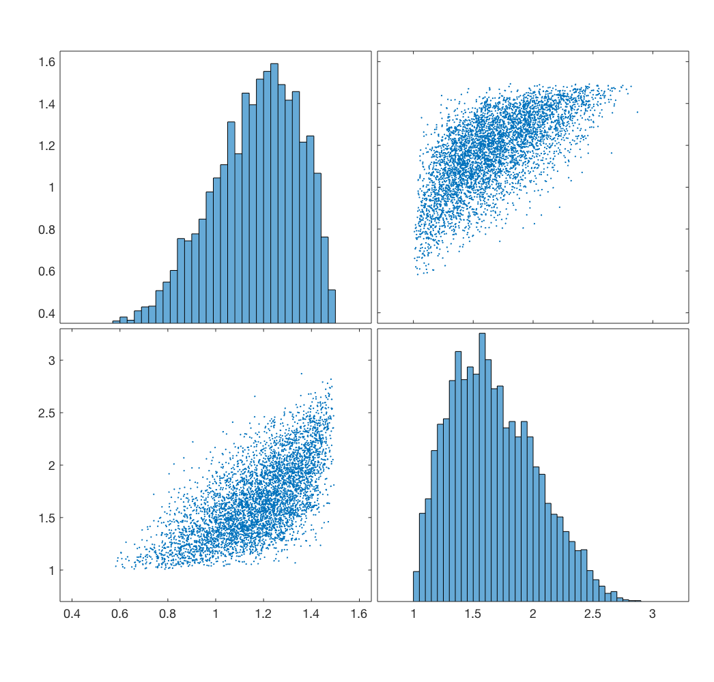






Inverse problems
?
$$y=f(x)$$
$$x_{2}$$
$$x=f^{−1}(y)$$
$$y_{2}$$
$$x_{1}$$
$$y_{1}$$

Slide 4
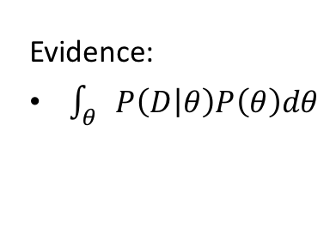

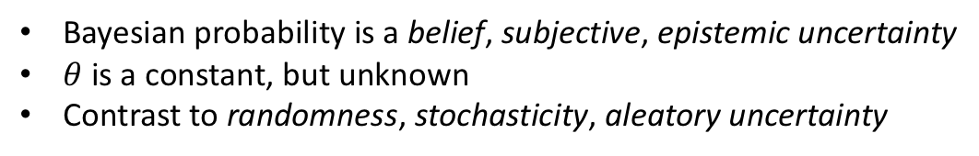
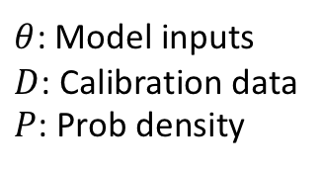
Bayesian updating
$θ$: Model inputs
$D$: Calibration data
$P$: Prob density
Likelihood:
“compares model to data”
Involves model evaluations
Prior:
“knowledge before data”
Pre-calibration
Posterior:
“knowledge after data”
Calibrated model
$$P\left(θ | D\right)=\frac{P\left(D | θ\right)P(θ)}{P(D)}$$
Evidence:
$\int_{θ}{P\left(D | θ\right)P\left(θ\right)dθ}$
Bayesian probability is a belief, subjective, epistemic uncertainty
$θ$ is a constant, but unknown
Contrast to randomness, stochasticity, aleatory uncertainty

Slide 5
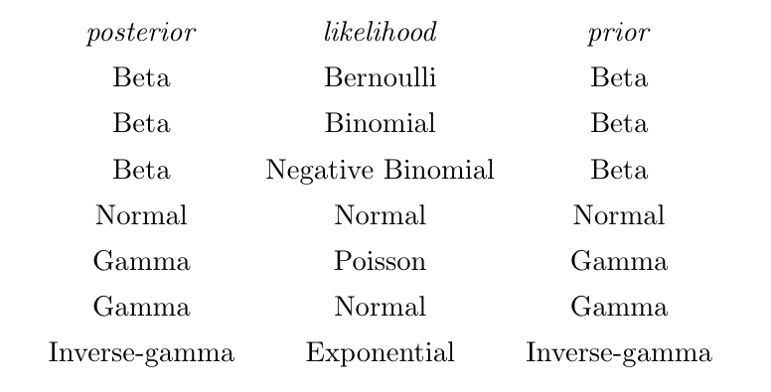
Conjugate priors
https://en.wikipedia.org/wiki/Conjugate_prior

Slide 6
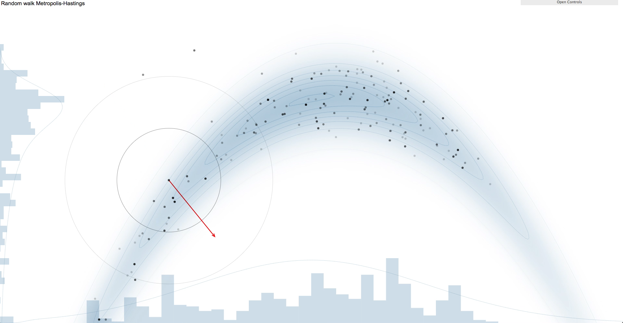




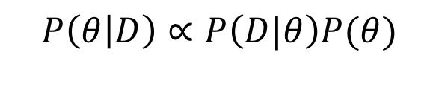

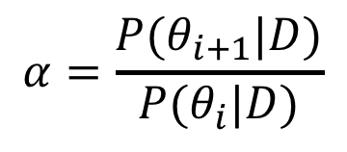

Markov-Chain Monte Carlo
$$P\left(θ | D\right)∝P\left(D|θ\right)P(θ)$$
Algorithm for sampling unnormalized distributions
Metropolis-Hastings
$$P\left(θ | D\right)$$
$$θ_{2}$$
$$α=\frac{P(θ_{i+1}|D)}{P(θ_{i}|D)}$$
$$θ_{1}$$
$$α>x→accept$$
$$x \sim U(0,1)$$
https://chi-feng.github.io/mcmc-demo/
$$α<x→reject$$

Slide 7
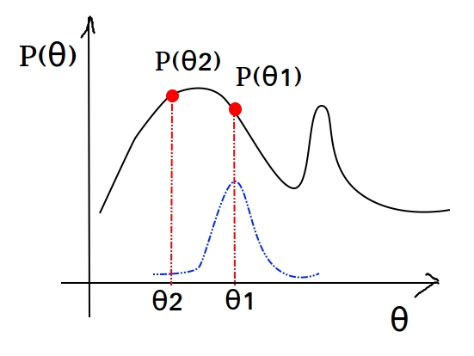
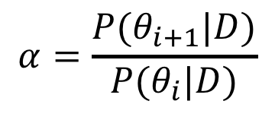

Issues
Metropolis–Hastings struggles with lots of peaks
    When there is lots of data
    Inverse problems are usually non-identifiable
    (lots of solutions/multi-nodal)
Struggles to accept at high dimensions
    Low acceptance rate
    Samples can be highly autocorrelated
    Hard to determine good proposal distribution
$$α=\frac{P(θ_{i+1}|D)}{P(θ_{i}|D)}$$
Doesn’t give you the evidence $P\left(D\right)$
    Model class selection
    Model averaging

Slide 8
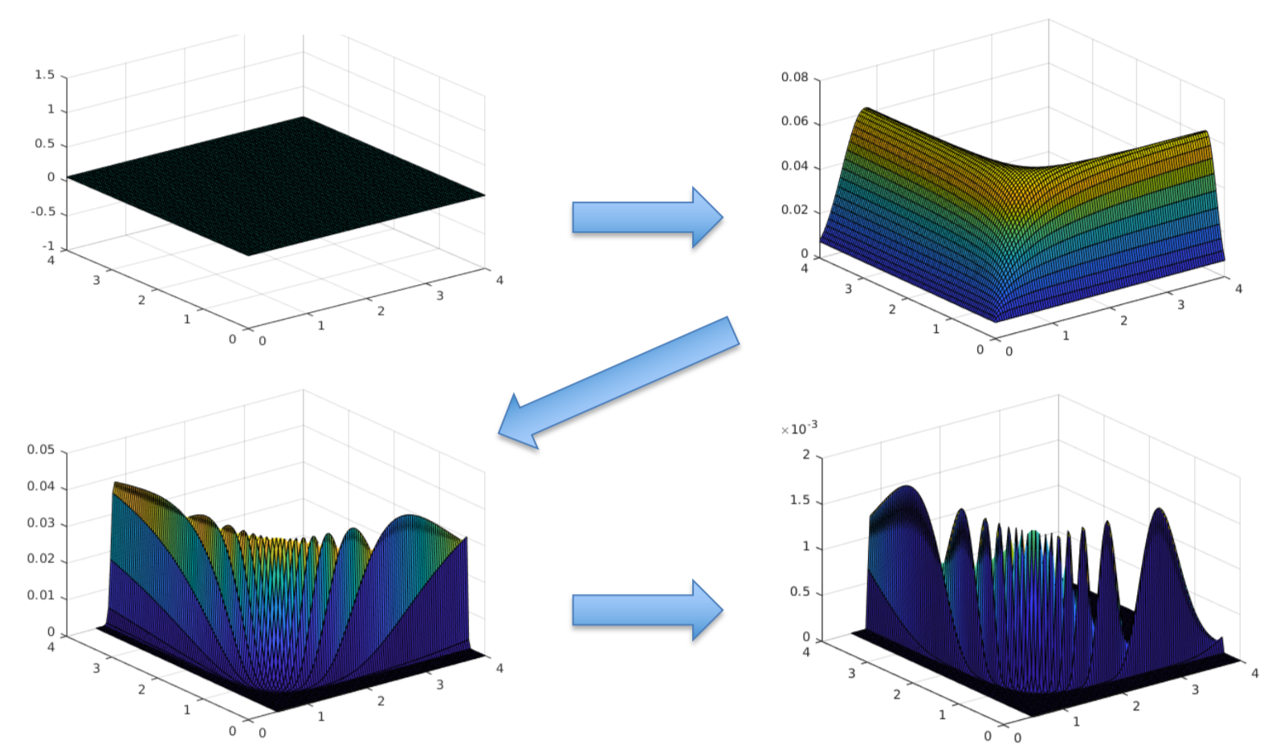


Transitional MCMC
Doesn’t sampling posterior directly
$$P_{j}\left(θ | D\right)∝{P(D|θ)}^{β_{j}}P(θ)$$
Several steps using easy ”transitional” distributions
$$0≤β_{j}≤1$$
$P_{0}\left(θ | D\right)$ - Prior
$P_{1}\left(θ | D\right)$ - Posterior
$∆β_{j}$ – selected so change in $P_{j},P_{j+1}$ isn’t dramatic

Slide 9
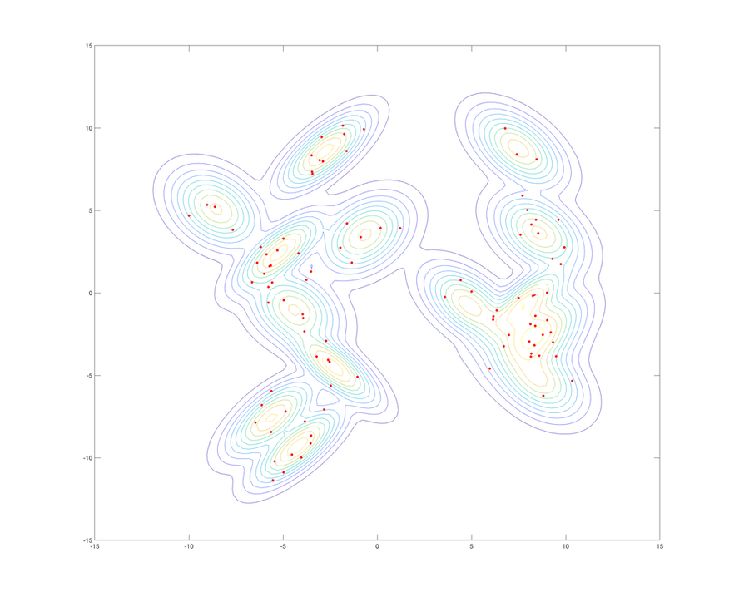
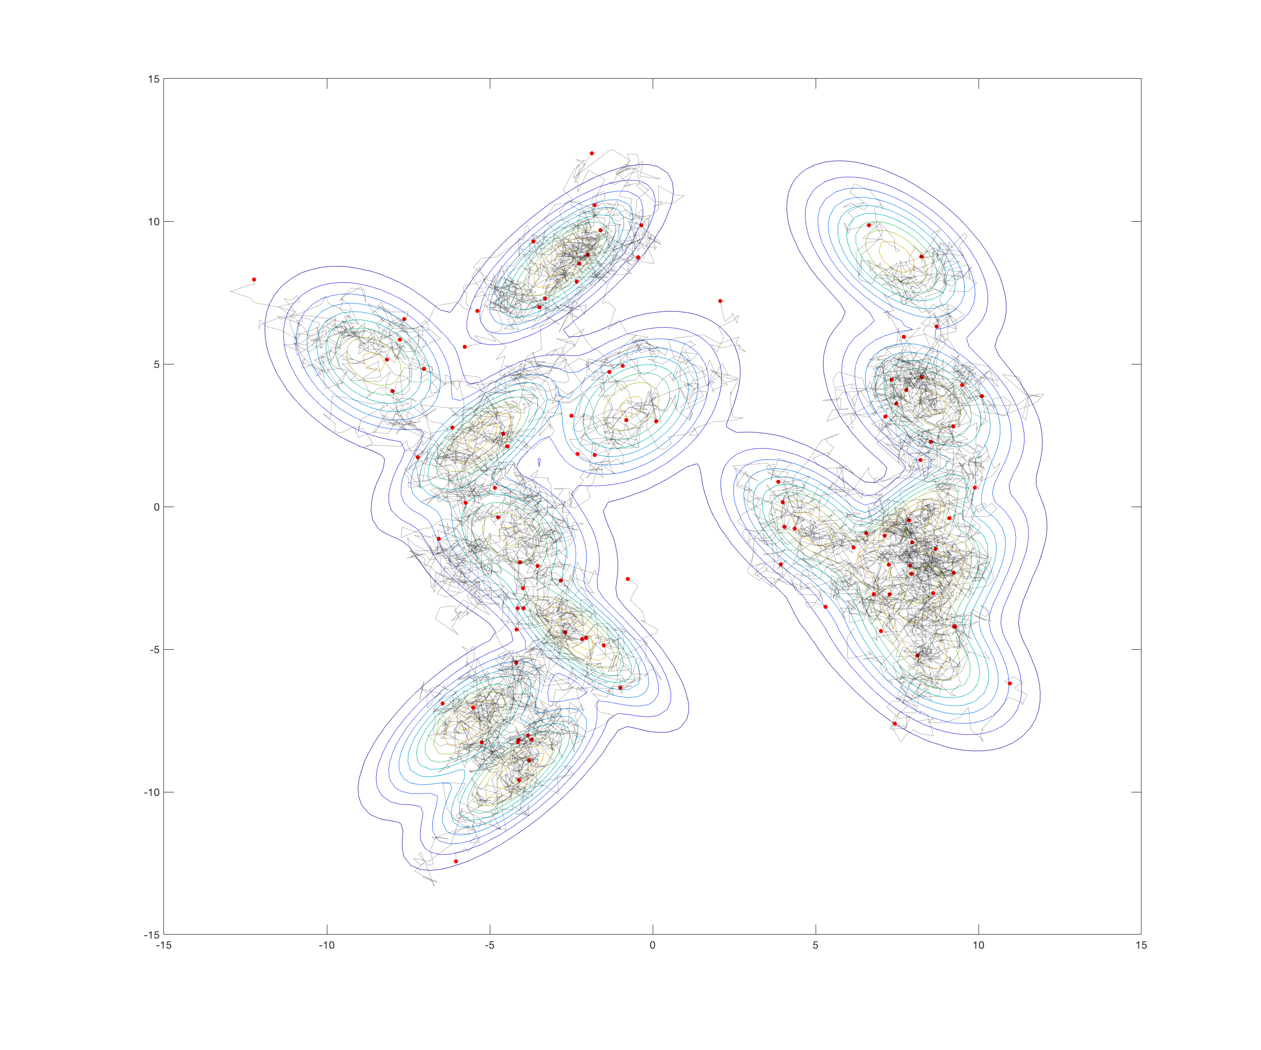
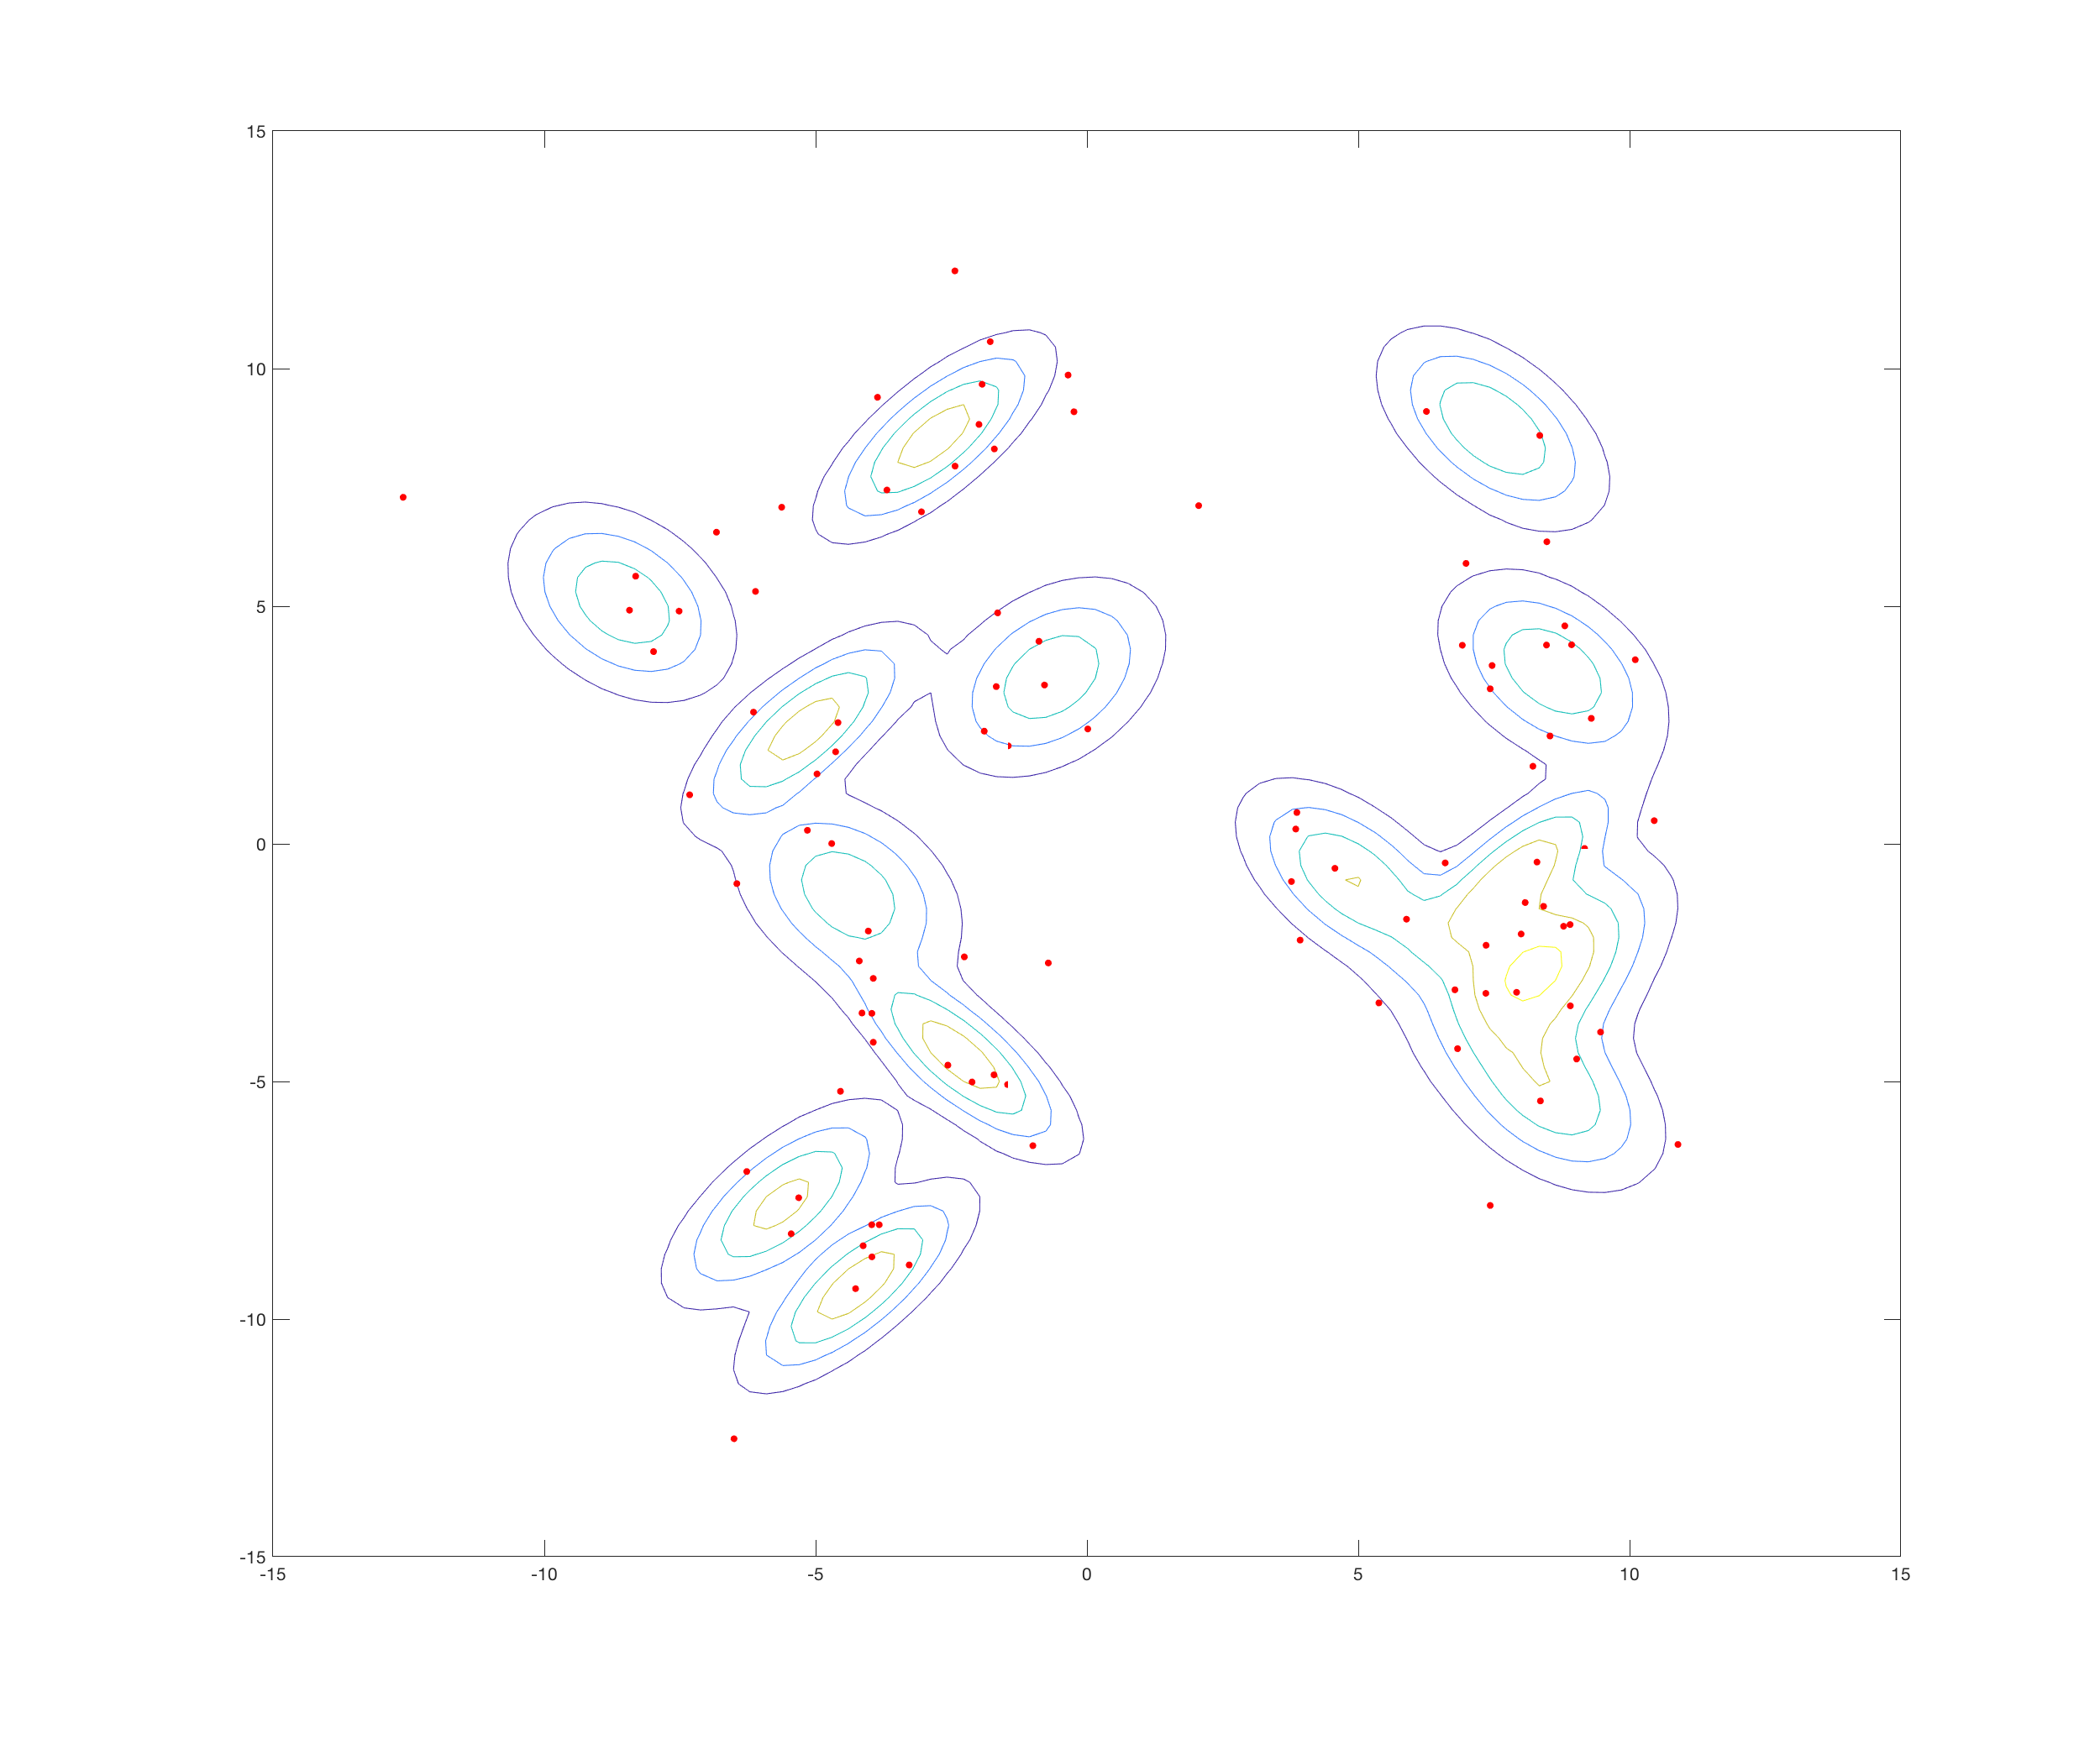
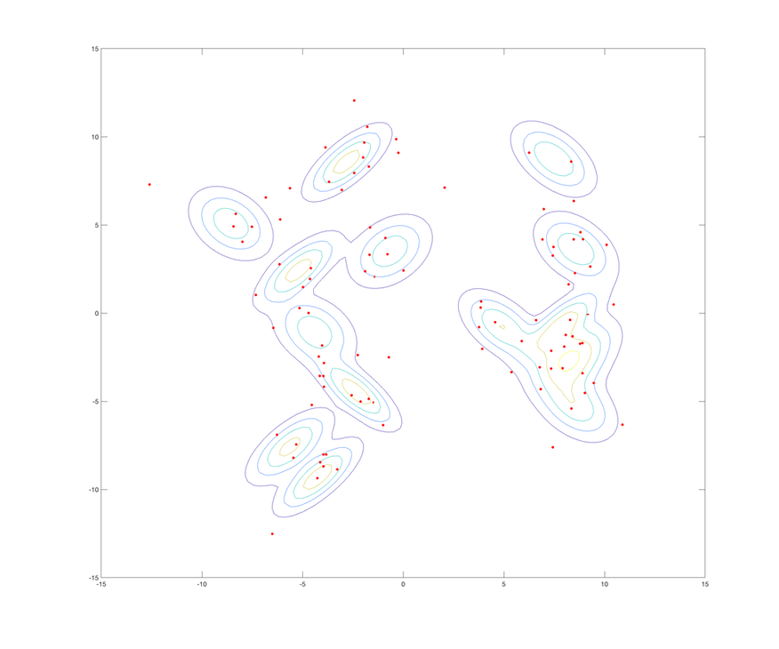
Transitional MCMC
Multiple chains used
One chain per sample
Easy to parallelise
Usually low burn-in needed

Slide 10
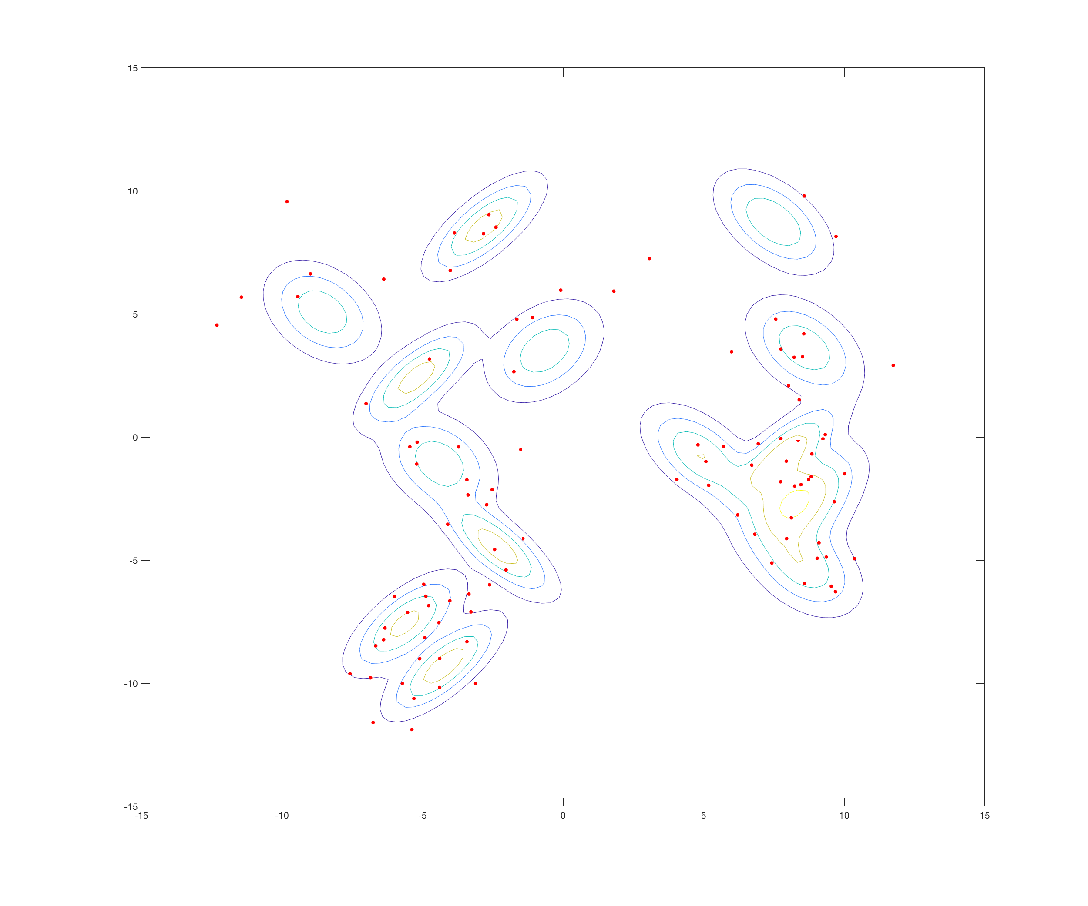
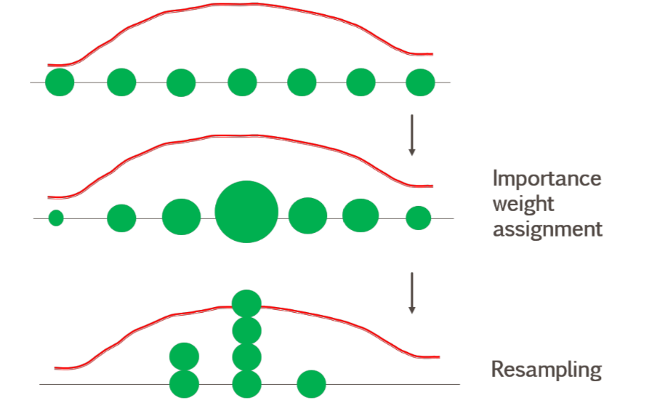
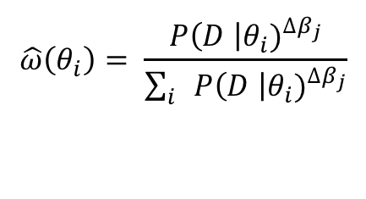



Transitional MCMC
Multiple chains used
Uses importance sampling
Resample according to $\hat{ω}\left(θ_{i}\right)$
$$\hat{ω}\left(θ_{i}\right)= \frac{{P\left(D \right|θ_{i})}^{∆β_{j}}}{\sum_{i}{{P\left(D \right|θ_{i})}^{∆β_{j}}}}$$
$∆β_{j}$ = $β_{j}$ - $β_{j−1}$
$P\left(D \right|θ_{i})$ – likelihood of $θ_{i}$

Slide 11
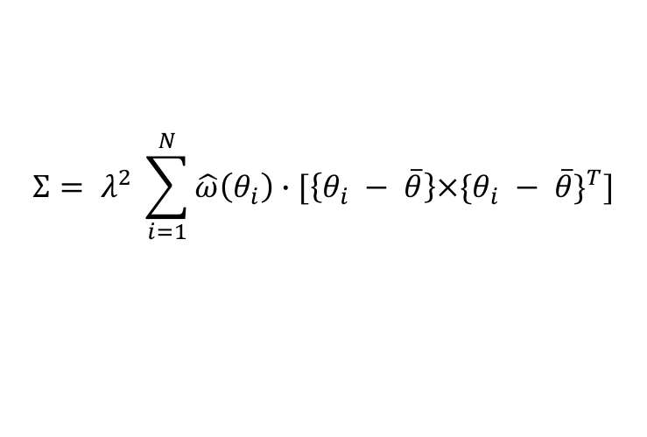


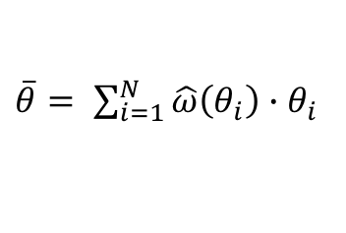
Transitional MCMC
Multiple chains used
Uses importance sampling
$$Σ= λ^{2} \sum_{i=1}^{N}{\hat{ω}\left(θ_{i}\right)}∙[\left\{θ_{i} − \overline{θ}\right\}×\{θ_{i} − \overline{θ}\}^{T}]$$
Proposal adapted each step
Normal with cov $Σ$
$\overline{θ}= \sum_{i=1}^{N}{\hat{ω}\left(θ_{i}\right)∙θ_{i}}$
$$λ=0.2$$

Slide 12
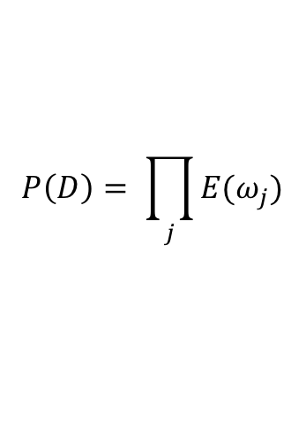
Transitional MCMC
Multiple chains used
Uses importance sampling
$$P\left(D\right)= \prod_{j}{E(ω_{j})}$$
Proposal adapted each step
Gives estimate of Evidence

Slide 13
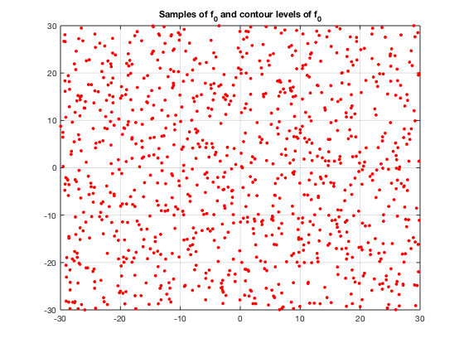
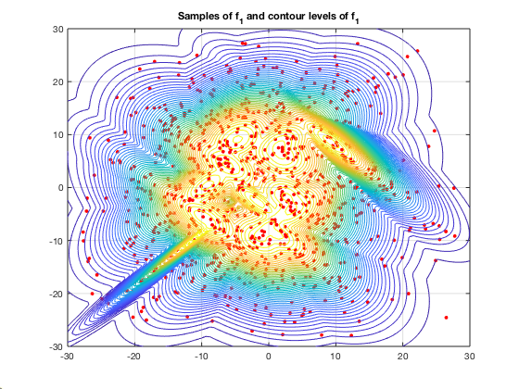
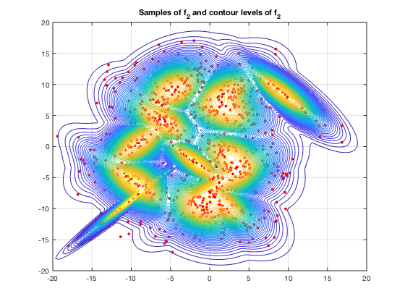
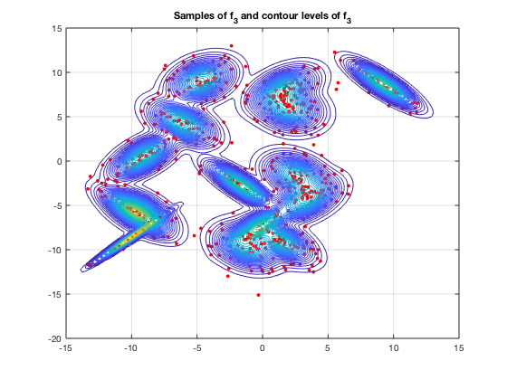
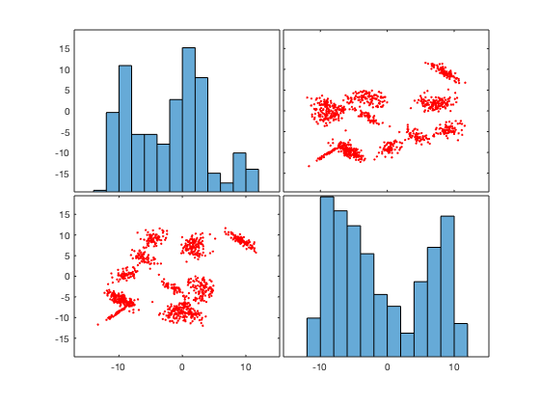
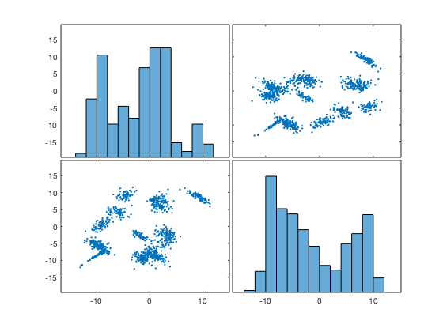





Example
$$β_{j}=0$$
$$β_{j}=0.015$$
$$β_{j}=0.085$$
$$β_{j}=0.484$$
$$β_{j}=1$$
Samples of Gaussians

Slide 14
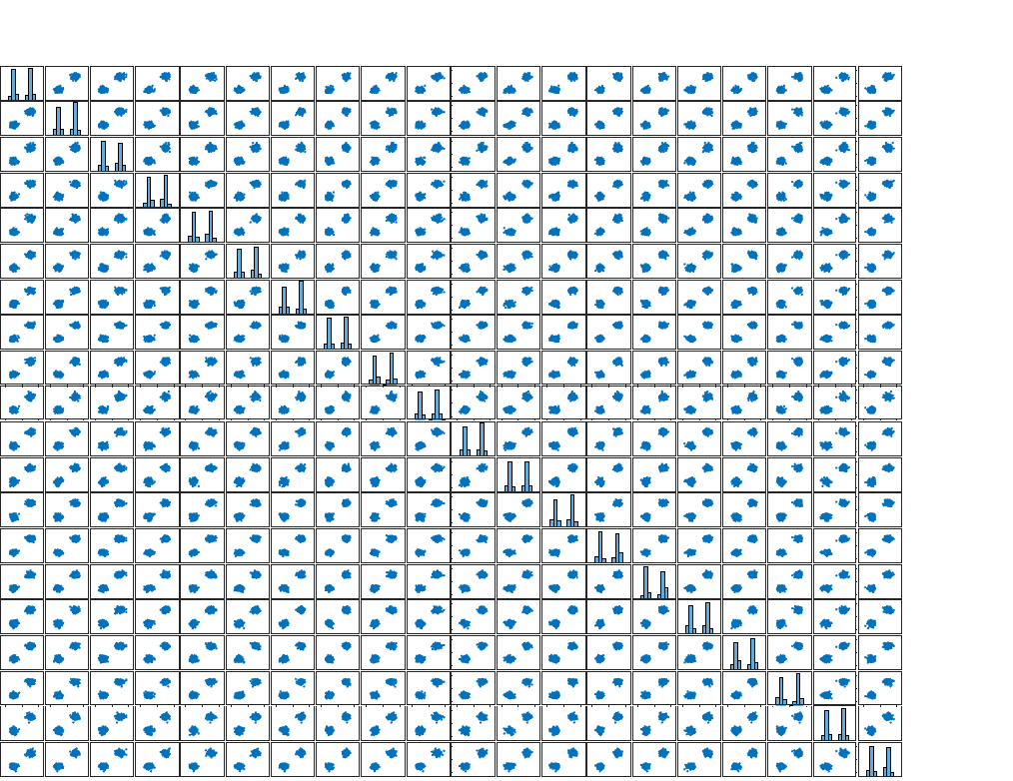
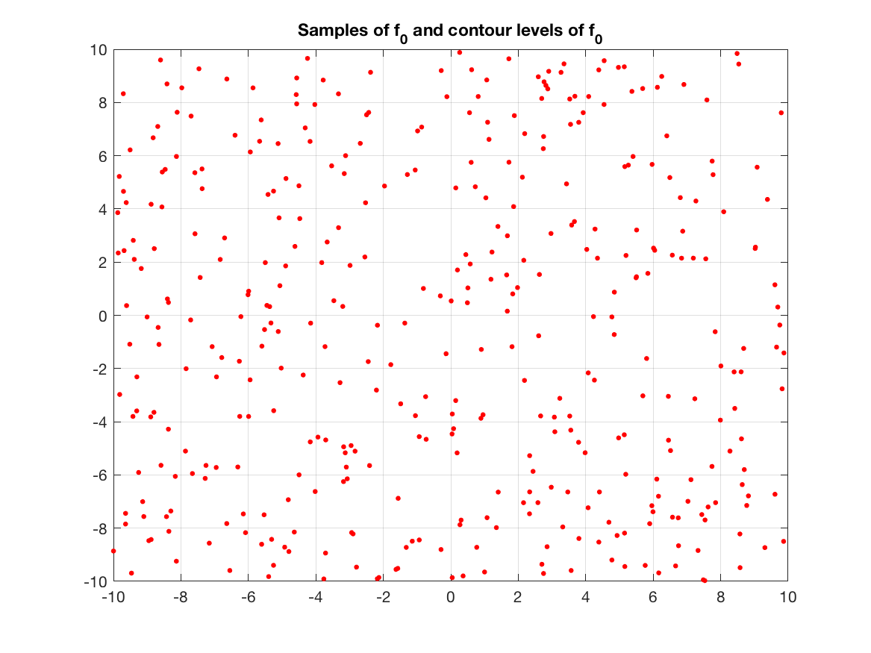
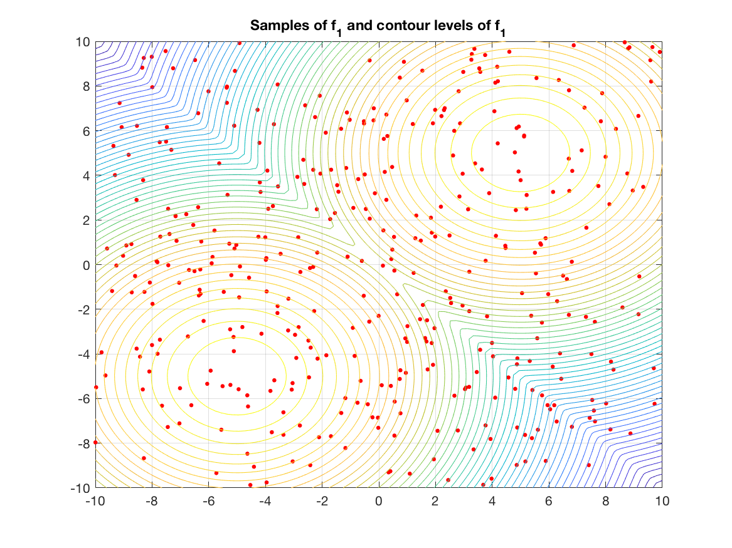
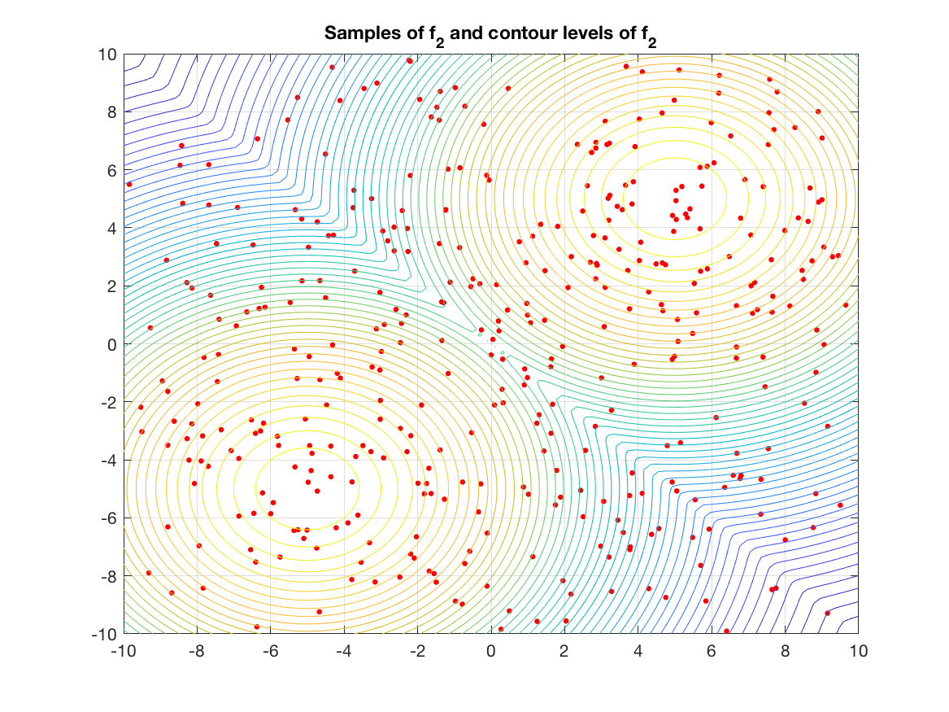
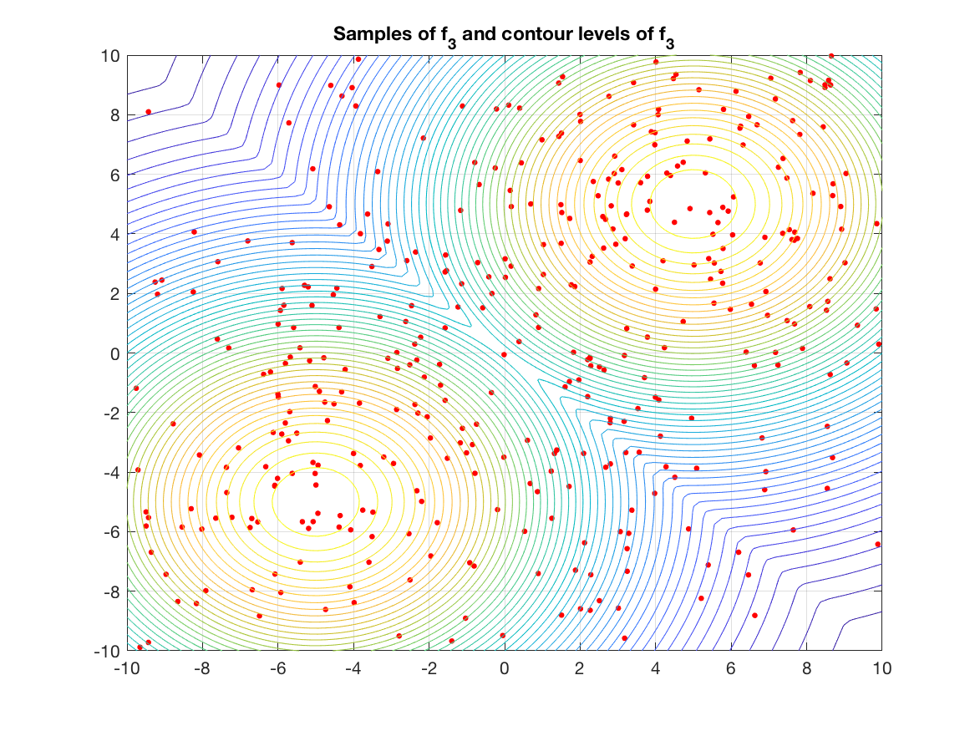
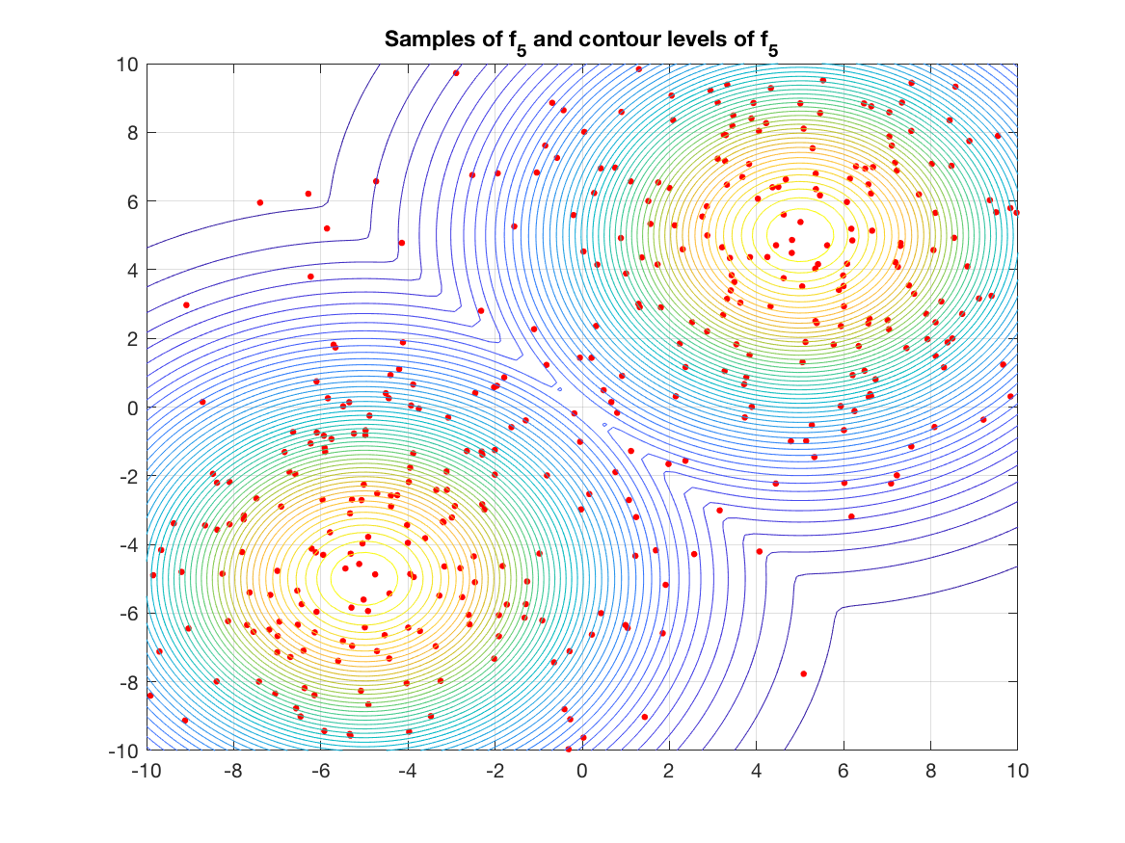
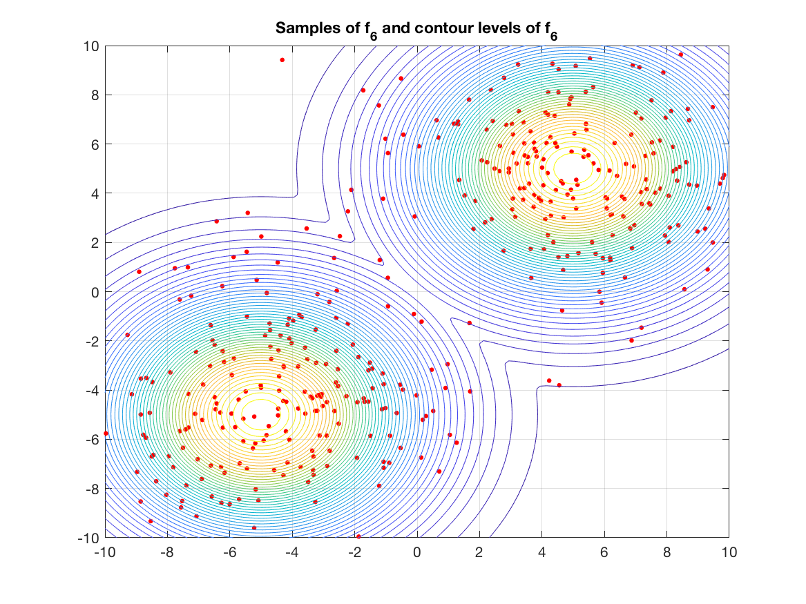
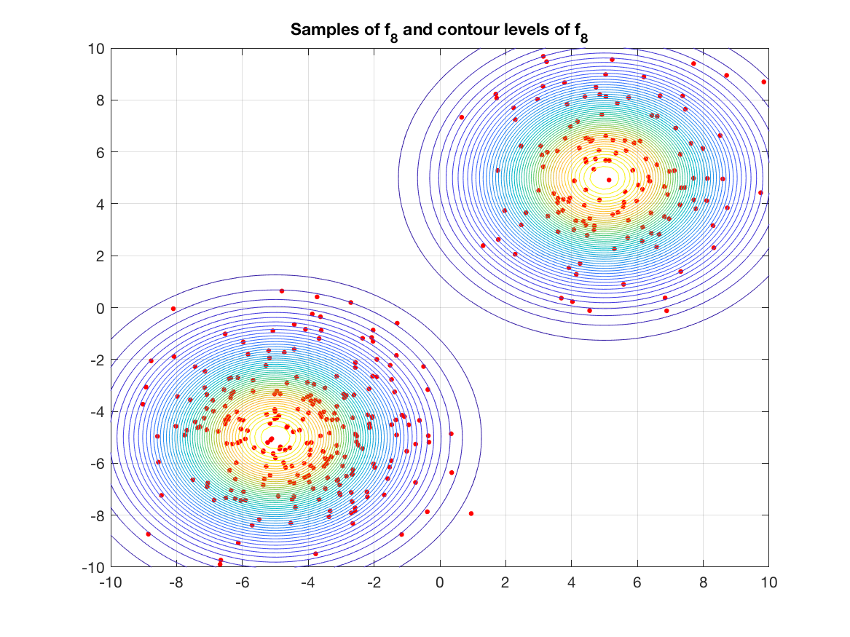
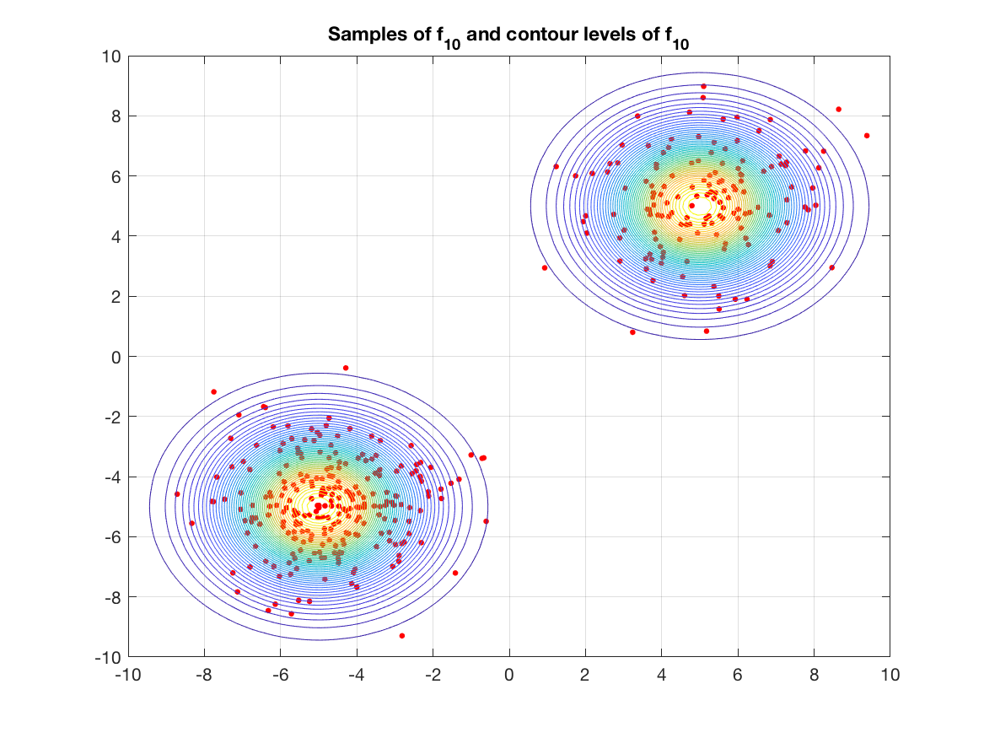
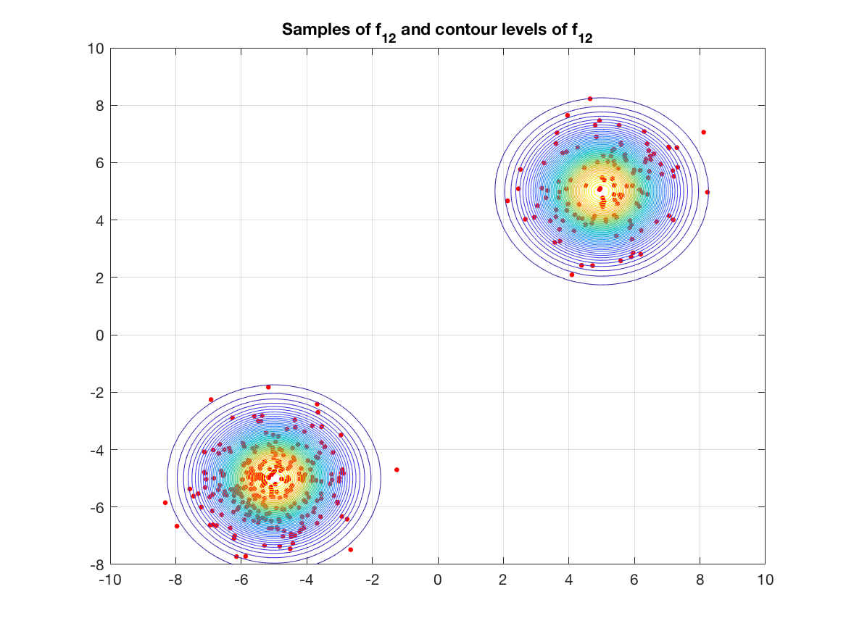
Example
Two 20 dimensional gaussians
Sampler gets masses correct

Slide 15
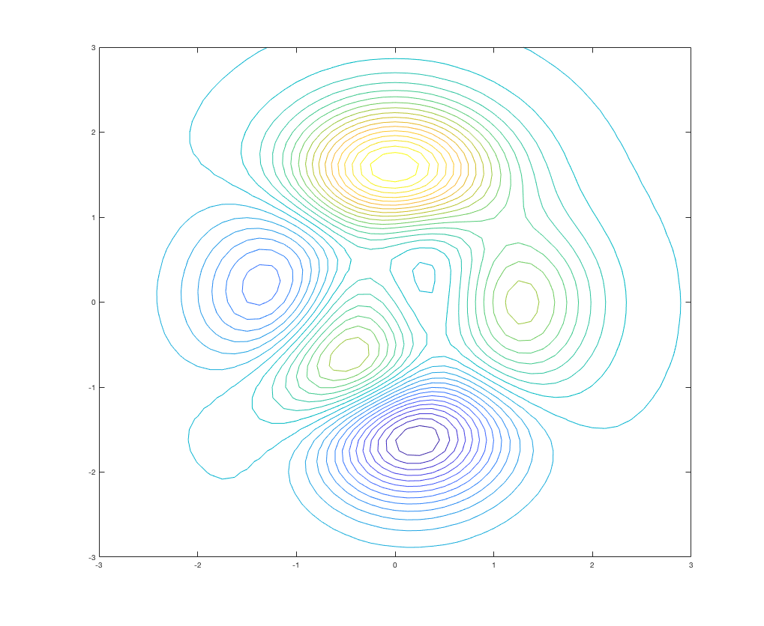
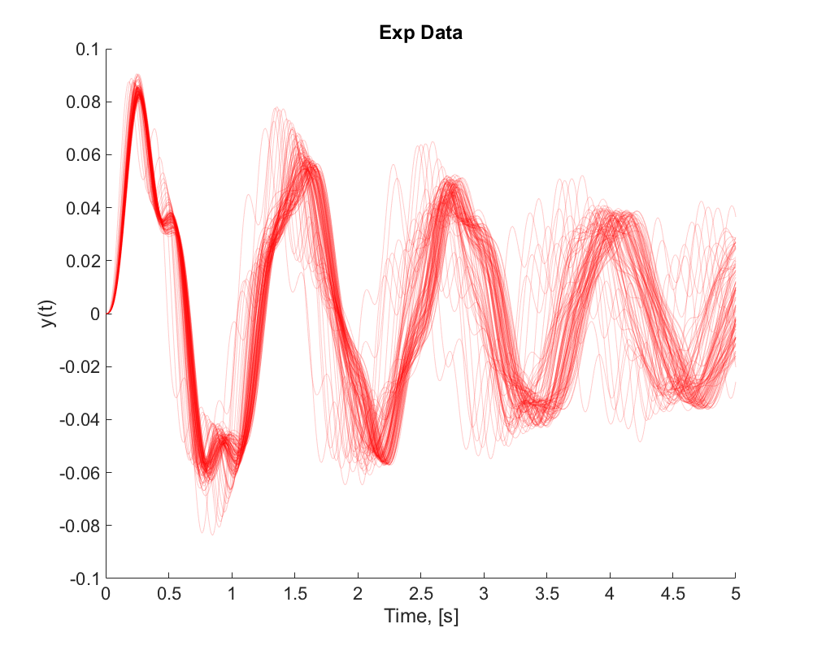
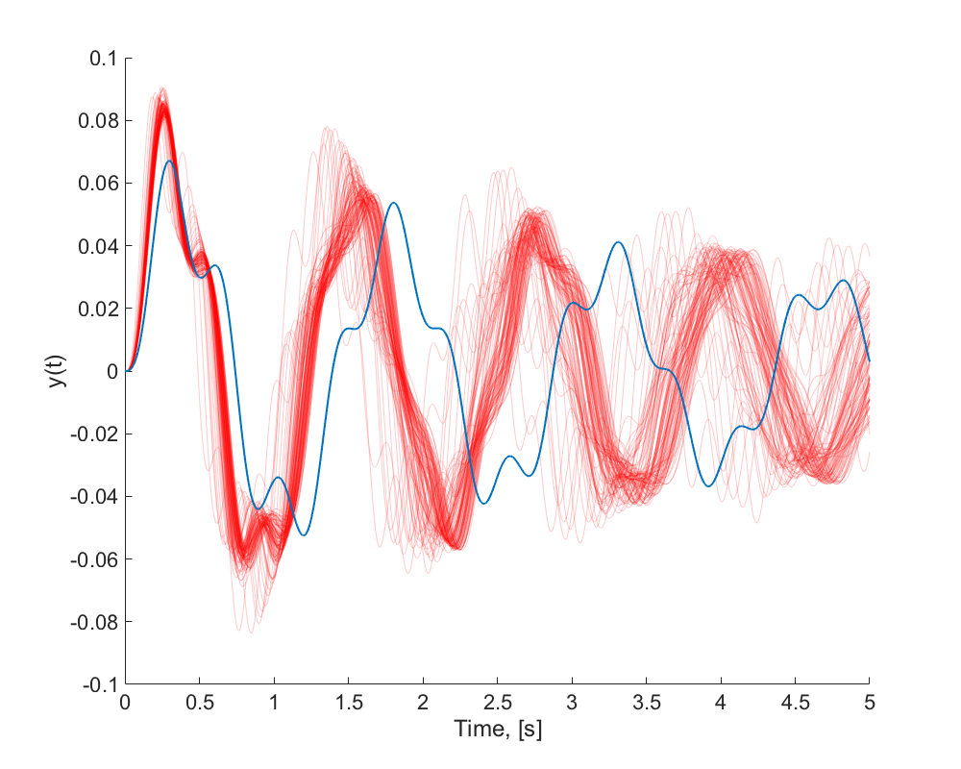
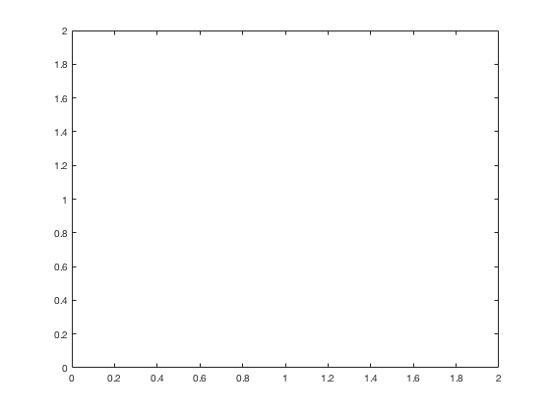













NASA 2020 UQ challenge
$$2$$
Inputs
Output
5 aleatory parameters
$$a_{2}$$
$$a ∈{[0,2]}^{5}$$
$$0$$
$$0$$
$$a_{1}$$
$$2$$
$$f(x)$$
$$2$$
4 epistemic parameters
$$e_{2}$$
e$∈{[0,2]}^{4}$
$$0$$
$$0$$
$$e_{1}$$
$$2$$

Slide 16



Parametric model for A
Each marginal will be beta distributed
The joint is created by sampling a random correlation matrix¹
$$a_{i} \sim Beta({ B1}_{i}, { B2}_{i})$$
$${B1}_{i}, {B2}_{i} ∈[0, 100]$$
$$ρ_{i,j} ∈[−1, 1]$$
10 extra epistemic parameters
10 extra epistemic parameters
10 + 10 + 4 = 24 dimensions
¹Harry JOE, "Generating random correlation matrices based on partial correlations." Journal of Multivariate Analysis

Slide 17
Parametric model for A
20 parameter parametric distribution

Slide 18
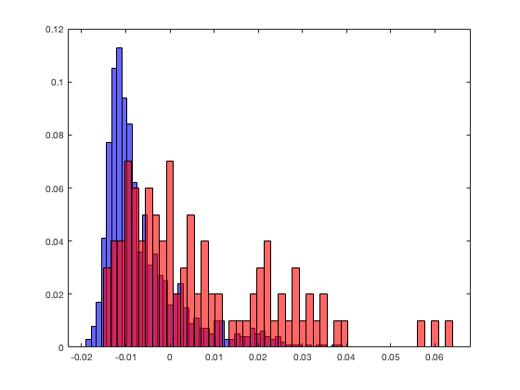
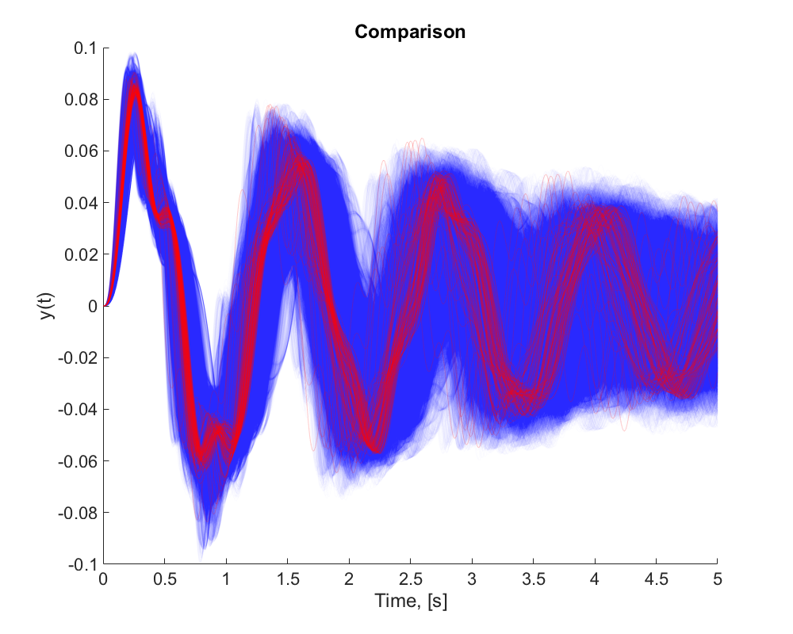
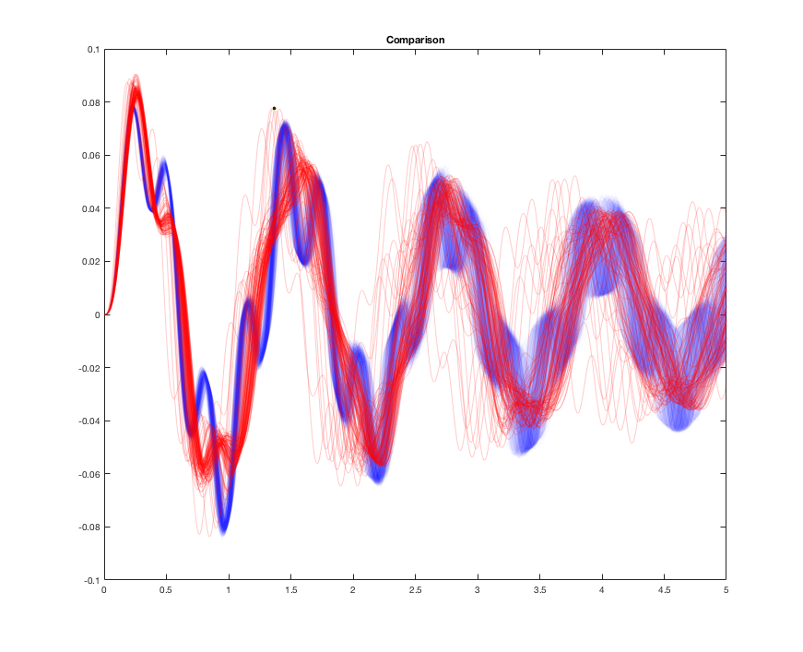
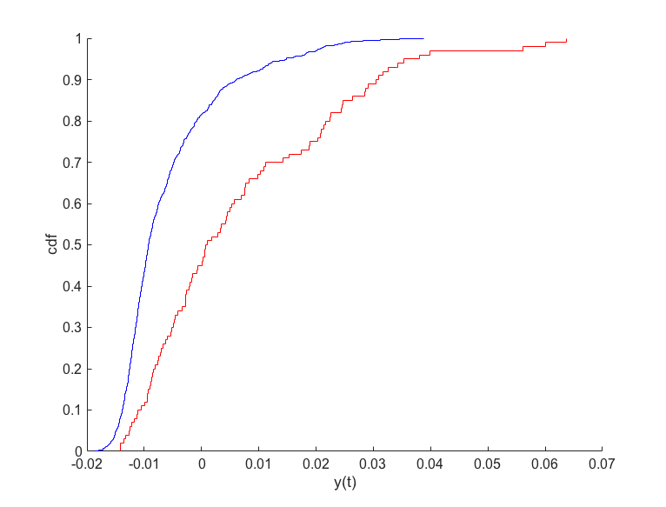
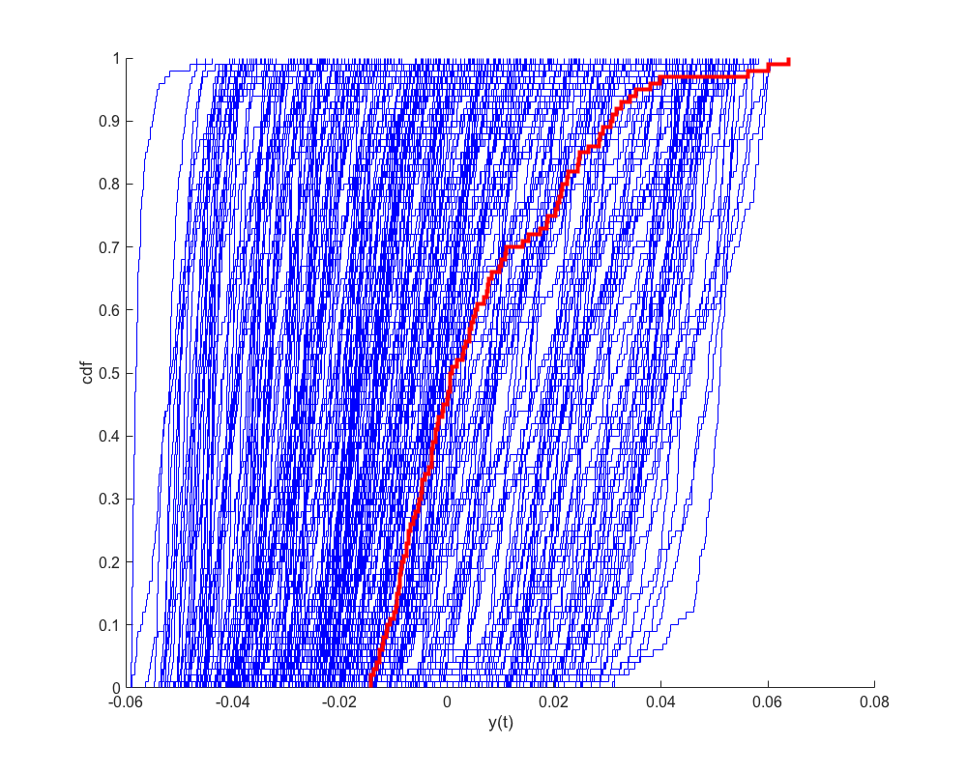
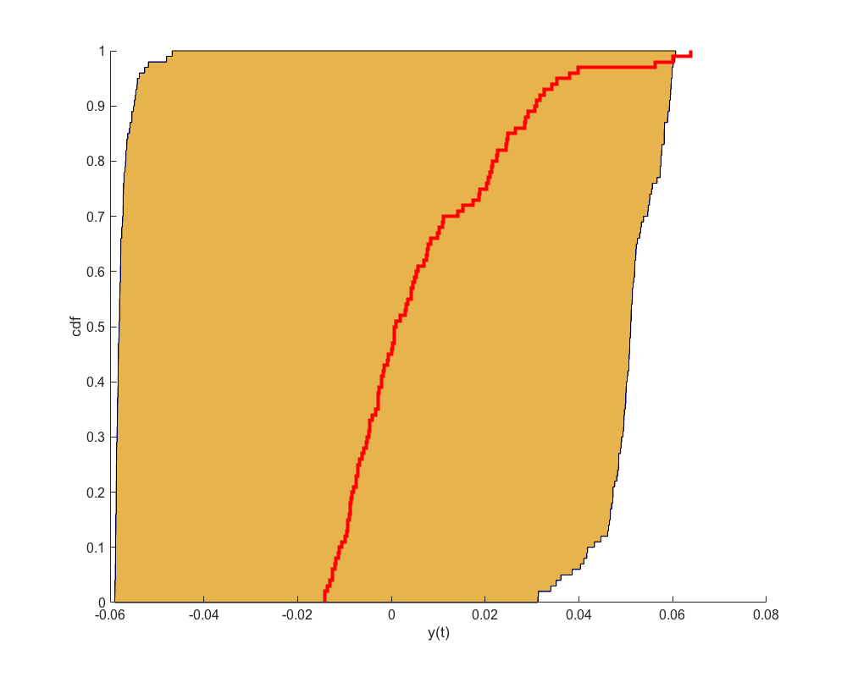
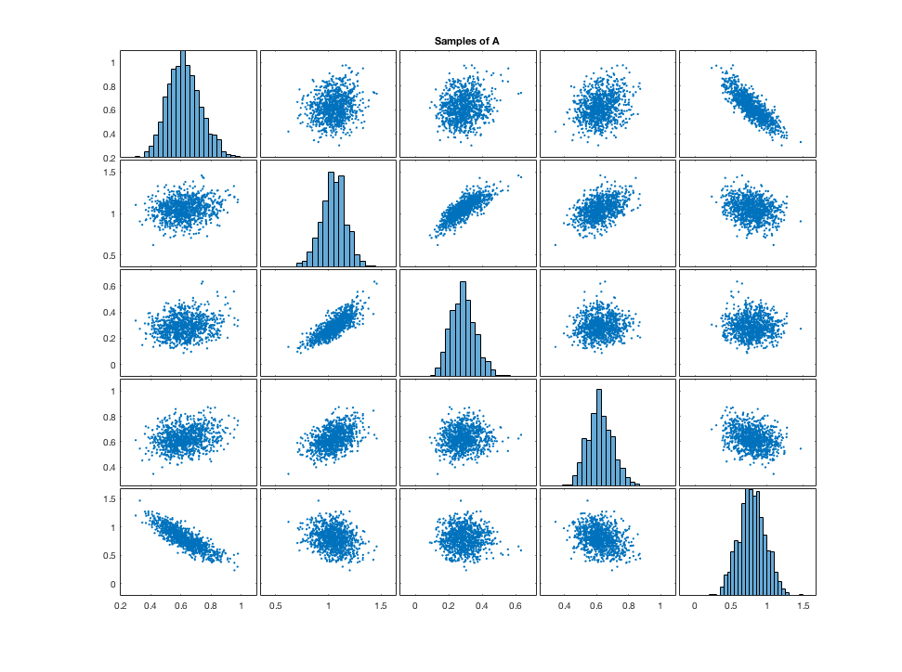




A set of probabilistic models
At t = 2.5s

Slide 19











Bayesian Calibration with sets of distributions
$$P\left(e_{i}\right|D) ∝P \left(D \right|{ e}_{i}) P(e_{i})$$
$$A$$
$e_{1:10} \sim U\left( 0, 100\right)$
$e_{11:20} \sim U\left(−1,1\right)$
$e_{21:24} \sim U(0, 2)$
$$P(e_{i})$$
$$∝exp⁡\{ − \frac{d^{2}}{ε^{2}}\}$$
$$d=A= \int_{−∞}^{+∞}{\left|P\left(y\right)−E(y)\right| dy}$$
$$P\left(D \right|e_{i})$$
$d$ : distance metric
$ε$ : “likelihood width” $∈[{10}^{−1},{10}^{−3}]$
Bi, Sifeng, Matteo Broggi, and Michael Beer. "The role of the Bhattacharyya distance in stochastic model updating." Mechanical Systems and Signal Processing 117

Slide 20










Calibrated Model
Calibrated output
Betas
t = 1 s
t = 2s
t = 3s
t = 4s
t = 5s
Partial Correlations
Original Epistemic

Slide 21
Conclusions
Transitional MCMC can overcome some issues with Metropolis – Hastings
Can sample complicated posteriors
Good in high dimensions (within reason)
Proposal selected by algorithm
Straightforward to parallelise
Gives the Evidence
OpenCossan (MATLAB): General UQ toolbox. TMCMC available in dev branch
Python/ Julia package coming in 2021

Slide 22
References
TMCMC:
Ching, J., & Chen, Y. C. (2007). Transitional Markov chain Monte Carlo method for Bayesian model updating, model class selection, and model averaging. Journal of engineering mechanics, 133(7), 816-832.
Bayesian false confidence:
Balch, Michael Scott, Ryan Martin, and Scott Ferson. "Satellite conjunction analysis and the false confidence theorem." Proceedings of the Royal Society A 475.2227 (2019): 20180565.
NASA:
Gray, A., Wimbush, A., DeAngelis, M., Hristov, P. O., Miralles-Dolz, E., Calleja, D., & Rocchetta, R. Bayesian calibration and probability bounds analysis solution to the Nasa 2020 UQ challenge on optimization under uncertainty.
2- loop updating:
Bi, S., Broggi, M., & Beer, M. (2019). The role of the Bhattacharyya distance in stochastic model updating. Mechanical Systems and Signal Processing, 117, 437-452.
Area Metric:
Ferson, S., Oberkampf, W. L., & Ginzburg, L. (2008). Model validation and predictive capability for the thermal challenge problem. Computer Methods in Applied Mechanics and Engineering, 197(29-32), 2408-2430.
Contact: Ander.Gray@Liverpool.ac.uk
Projects: https://github.com/AnderGray

Slide 23
Acknowledgements
Andrew Davis, Culham Centre for Fusion Energy, UKAEA
Scott Ferson, Institute for Risk and Uncertainty, University of Liverpool
NASA challenge collaborators: Marco De Angelis, Roberto Rocchetta, Alexander Wimbush, Enrique Miralles-Dolz, Peter Hristov, Dominic Calleja
Funding support from EUROATOM and EPSRC, through iCase studentship award and grand agreement No. 633053
Contact: Ander.Gray@Liverpool.ac.uk
Projects: https://github.com/AnderGray

Slide 24



Calculating $β_{j}$

